Slide 1

Hackathon - briefing
Green Sentiment Analysis

Slide 2
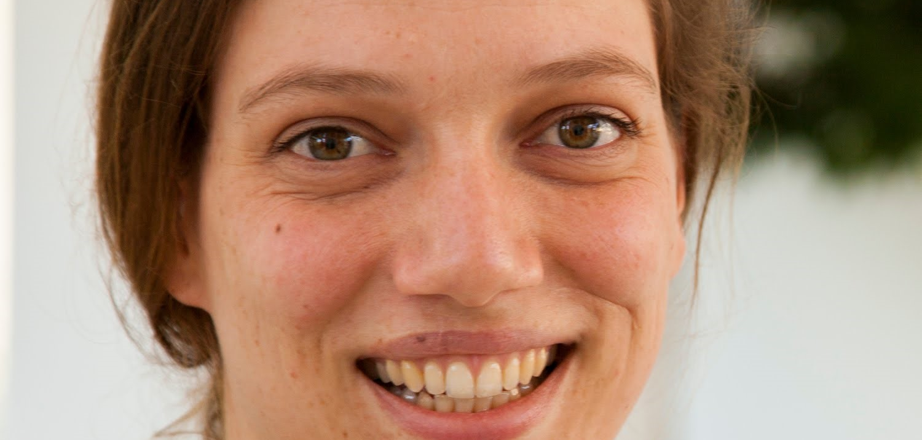
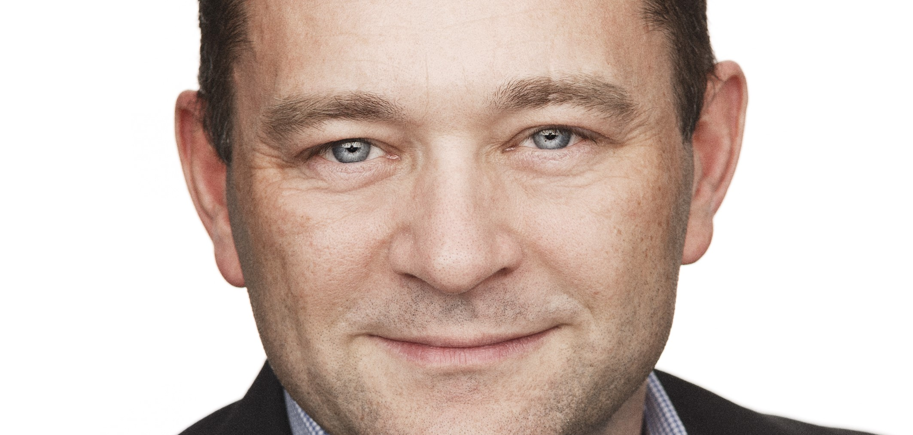


Welcome!
Hackathon: Green Sentiment Analysis
Maja Hanne Kirkeby
Associate Professor, Department of People and Technology, Roskilde University
Michael Wätjen
CCO & Partner Nine A/S

Slide 3
Meet the sponsors of this event
Hackathon: Green Sentiment Analysis
Nine A/S
Danish IT consultancy. Invention and planning of this hackathon idea.
Organiser & Main sponsor.
Energy Cluster Denmark
Energy Cluster Denmark is a neutral, value-creating and member-driven innovation platform for establishing and facilitating innovation collaborations between small and large companies, knowledge institutions and public players throughout the energy sector.
Organiser & Knowledge Partner.
Roskilde University
Leading Danish University. Invention and planning of this hackathon idea.
Organiser & Sponsor.
Danish ICT Industry Association
The Danish ICT Industry Association (IT-Branchen) works to create a strong and digital community which exploits the full potential of the technologies for the benefit of the economy and the individual.
Sponsor.

Slide 4
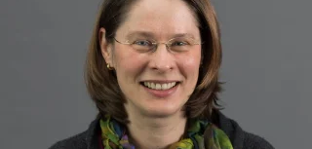

Meet the judges
Hackathon: Green Sentiment Analysis
Kerstin I. Eder
Professor, Bristol University, United Kingdom (leading expert in energy modelling and autonomous systems)
João Saraiva
Ass. Prof., Minho University, Portugal (leading expert in energy efficiency analysis with emphasis on mobile applications)

Slide 5
The assignment - 1
Hackathon: Green Sentiment Analysis
In connection with an increasing need for monitoring and control of data on the Internet, we need an easy and quick way to assess whether a text is positively or negatively charged.
We, therefore, need an energy-efficient solution that can take texts in different formats, analyze them, and provide a categorisation: 0 for negative, and 1 for positive.
To solve the task, we will use a data set with approx. 30,000 movie reviews and sentiments as training data. The data comes in different formats and with slightly varying content (not just plain text).
To see the full description and download data, go to
https://github.com/SustainableSoftware/Green-Hackathon-2023.git

Slide 6
The assignment - 2
Hackathon: Green Sentiment Analysis
To solve the task, the team must do the following:
Develop a sentiment analysis that can assess whether a film review is positively (represented with 1) or negatively (represented with 0) charged. Training the model can be done using the 30,000 film reviews and sentiments that we provide, referred to as training data. Testing of the system takes place with another 10,000 film reviews, which are not handed out; this set will be referred to as test data. There are also a small extra set of data, which are only meant for checking that your setup of the evaluation-script works correctly before hand-in; this set will be referred to as development data.

Slide 7
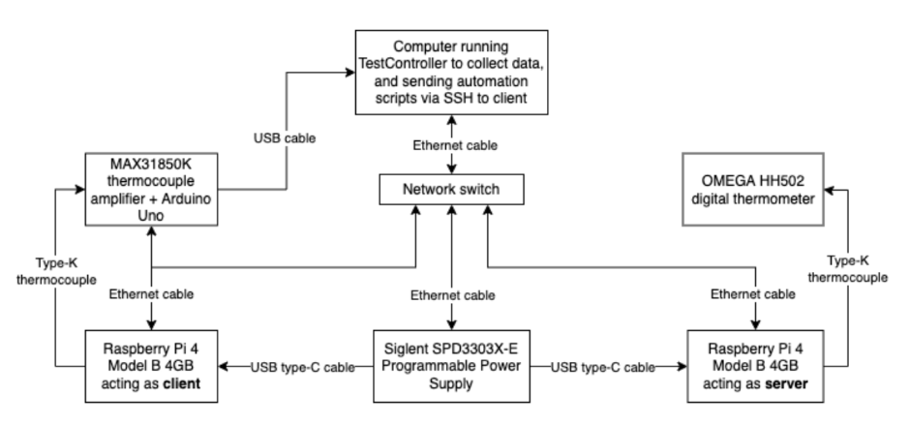
The assignment – technical setup
Hackathon: Green Sentiment Analysis

Slide 8
The assignment - 4
Hackathon: Green Sentiment Analysis
This Hackathon is part of a research project on Energy Consumption of Software and handed-in solutions are published as open source under the GNU General Public License v3.0 or later.
The aim is to learn from you and your experiences.
Thus, after the event, we will, first, measure the energy consumption of your program to determine a winner. But, in addition, we will (1) send each of you a small questionnaire to gain insights into your line of thought and experiences, and (2) analyse all the individual parts of your solutions. We aim to publish a paper with your solutions and experiences.

Slide 9
The assignment - 5
Hackathon: Green Sentiment Analysis
You need to upload your solution before the deadline.
The deadline is 21:00 CEST Sunday the 14th of May.
To hand-in your solution, you or your team should
a. Create a private GitHub repository (include a list of all team members’ names in the readme file)
b. Invite MHKirkeby as admin in your repository (and otherwise only your teammates)
c. Upload your solution into the github repository before the deadline; the last push commit before deadline is the one that counts.
Please carry out step A and B as soon as possible.
Please be aware that we will copy the content of your private repository to our public repository, afterwards. Contact Maja H Kirkeby via majaht@ruc.dk before 1st of June 2023 if you prefer that we remove your names from the readme file before publishing
Make sure that your uploaded solution contains all the specified parts in the above.

Slide 10


The prize
Hackathon: Green Sentiment Analysis
Conference tickets
Flight tickets
Accomodation
Diets
https://g otoams.nl/2023

Slide 11
Thank You!
Hackathon: Green Sentiment Analysis
CCO & Partner
Michael Wätjen
mwa@nine.dk
+45 41882388

